Slide 1
Chairperson’s Report 2008-2010
POSITIVE SERVANTS (NPO)
Chairperson: P.H MOTAUNG

Slide 2
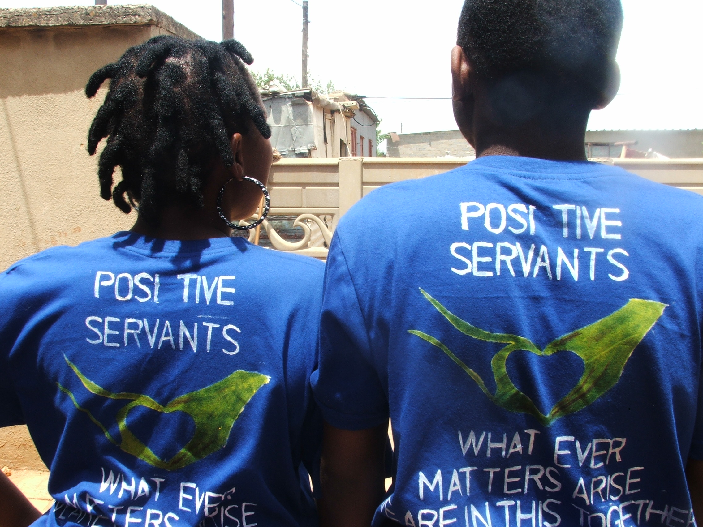
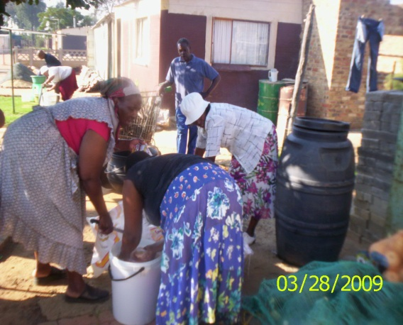
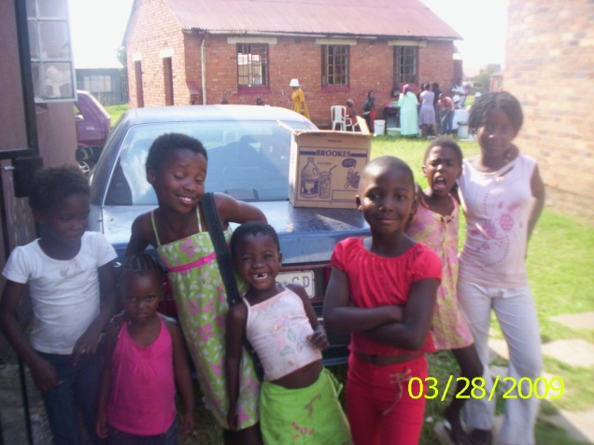
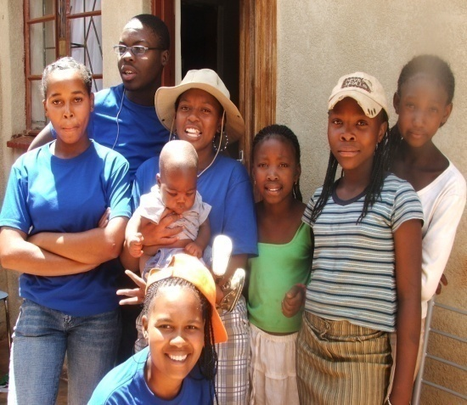
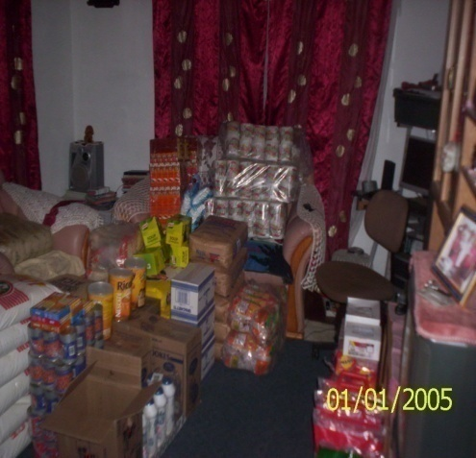
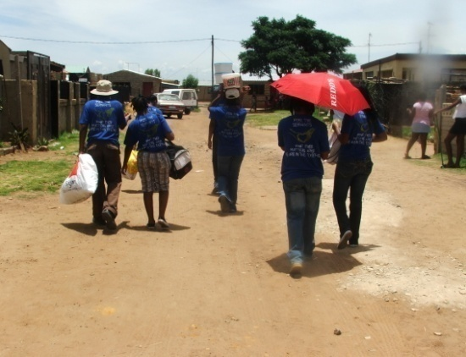
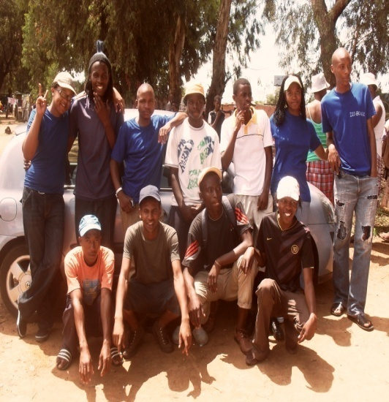

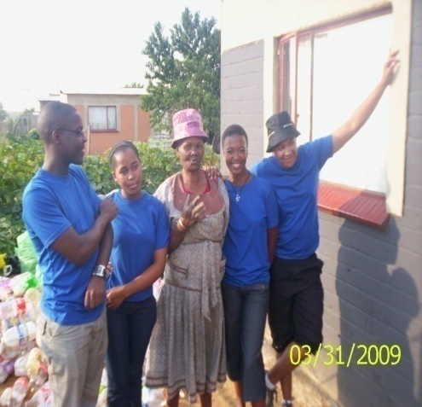
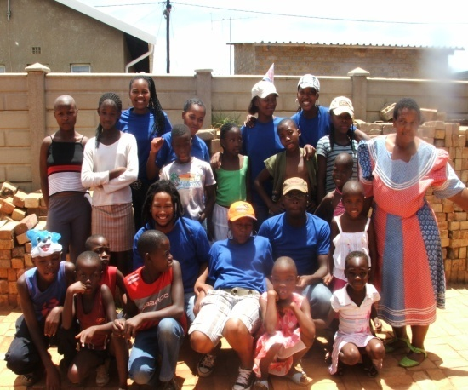
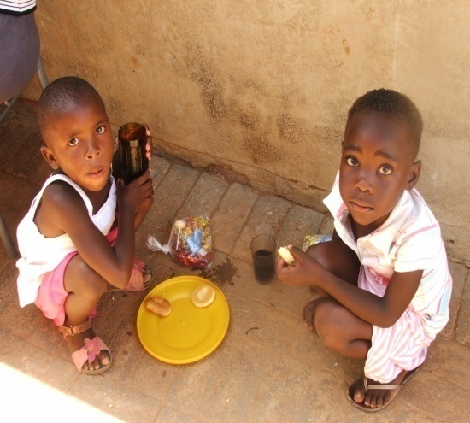
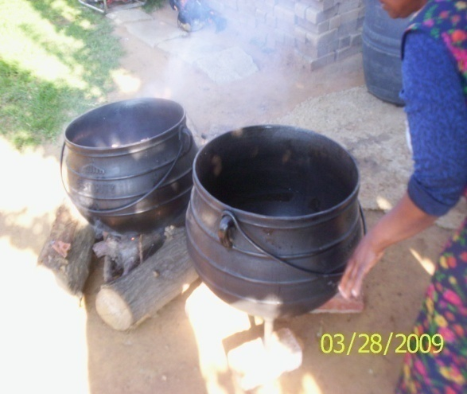
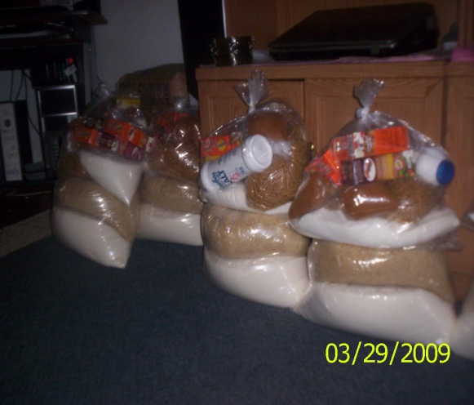
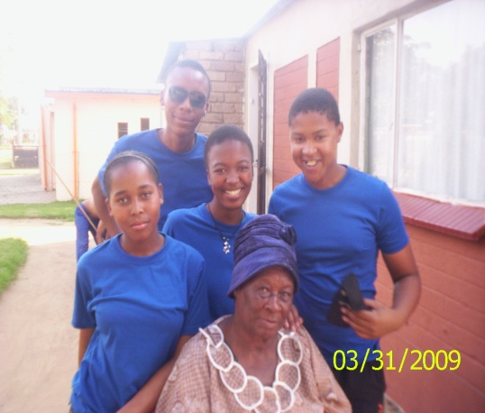
2008 to 2010 Chairperson's Report

Slide 3
It is with great pleasure to begin or start this report by introducing the slogan of the organisation, which is also the key motivator to the organisation and individual members of the organisation.
“Whatever matters arise we are in this together”

Slide 4
Brief Introduction
We are a Non-Profit organisation by the name of Positive Servants which has been established in order to improve the living conditions of the society or community, more especially the needy and sick. The main purpose and aim of the organisation is to serve (the community) not to be served.
The organisation is registered under the Non-profit Organisations Act No, 71 OF 1997. The organisation started in November 2008 under the supervision of the following people; Sophia Makgale, Makgadi Malete and Paseka Motaung. After November 2008 the organisation kept growing from 2008 till 2010 because of the existence of more, innovative, energetic and very determined chosen or selected youth of Sharpeville. The organisation managed to host an event immediately after it was formed in November 2008.
The organisation is not only driven by its goals and objectives but it is also driven by the existence of its belief, faith and trust to the Almighty GOD. The organisation’s existence is not determined by the existence of poverty, unemployment, orphans and old age, but the existence of the organisation is determined by the love and values the individual members and the organisation at large have for the community or society.

Slide 5
AIMS AND OBJECTIVES
1.1 To be a helping hand to the community more especially to the needy and sick.
1.2 We seek to be a loving and caring organisation through the actions or deeds that will in turn improve the living conditions of the society or community at large.
1.3 To care for the welfare of the disadvantaged groups .
1.4 To uplift the human spirit through the utilisation of sponsors, donation, events, and others.
1.5 To reduce the impact of poverty and unemployment to the community.
1.6 To be a helping hand of the government and other awareness organisation in creating a healthy society.
1.7 To serve not to be served

Slide 6
Organisation’s structure
Chairperson: Paseka Harry Motaung
Acting Vice Chairperson: Happy John Soso
Treasure: Makgadi Evelyn Malete
Secretary: Masesi Lydia
Vice Secretary: Bongani Dlova
Legal Officer: Lehloonolo Maile
P.R.O: Happy John Soso

Slide 7
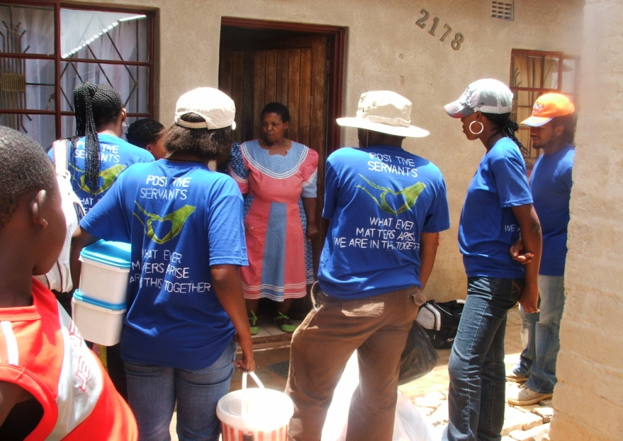

ACHIEVEMENTS
2008 December (ORPHANAGE)
In 2008 December the organisation hosted its first event for the orphans in an orphanage in Tshepiso Phase 1 under the supervision of Ms Sebongile.
Because the organisation by that time was still under the registration process we didn’t get funding or sponsors from big businesses or companies but the event was a success through the donations and sponsors from the community and the small enterprises around Sharpeville.

Slide 8
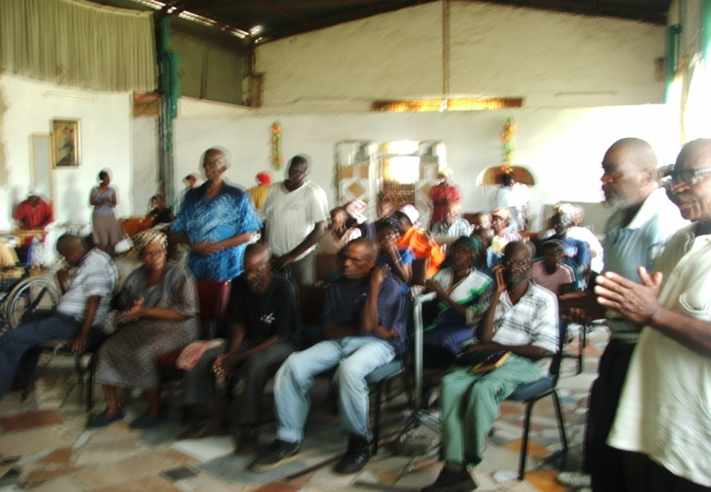
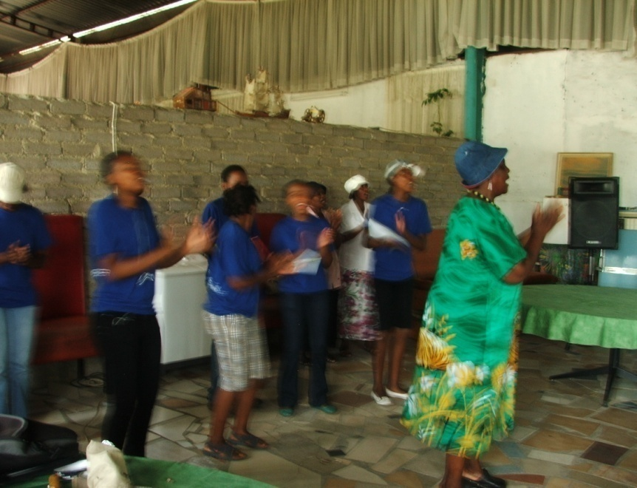
2009 January (DB OLD AGE)
In 2009 January the organisation hosted its second event in Sharpeville for the old age at a shelter by the name of DB OLD AGE which is under the supervision of Ms Kotu. We discovered in the event that the shelter isn’t sponsored by any company and most of the old age did not have the Identity Documents. This is one of the reasons it is even difficult for the Ms Kotu to reach all the needs of the old age in that shelter especially food.

Slide 9
D.B old age continues...
The event was a success. We had the community members helping us with catering, donations, and others including a short church service at the beginning of the event.
Later that year (January to May) we managed to work hand in hand with the Home Affairs to make the identity documents for the old age and this is also one of our project which was a success.
We again managed to donate two beds for the old age because of the patients there didn’t have the beds to sleep on which is one the things which causes issues such as back pains, strain, and other physical problems.

Slide 10



2009 March (Baptist)
2009 March the organisation hosted its third event were most of the disadvantaged groups were in invited including the orphans. The organisation managed to get the sponsor from Nkosi’s Heaven which was named after the death of Nkosi Johnson which is under the supervision of Gail Johnson (Director), and the Soweto gospel choir which is based in Soweto but going all over the world spreading the gospel through music. With the sponsors which we received we also managed to make the food parcels for the group and entertainment and motivation was also the important part of the event. We also got the help from the community members to prepare the food or for catering. In conclusion the event was a success.

Slide 11
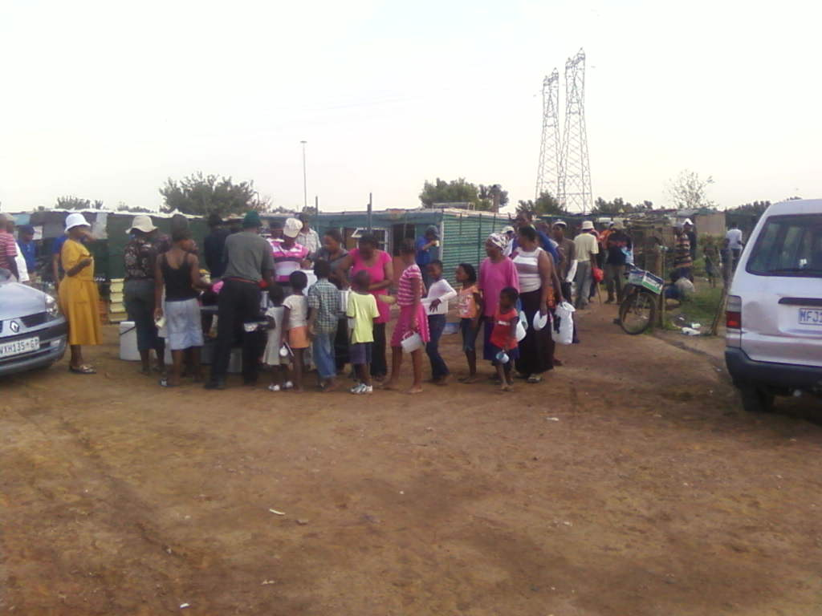
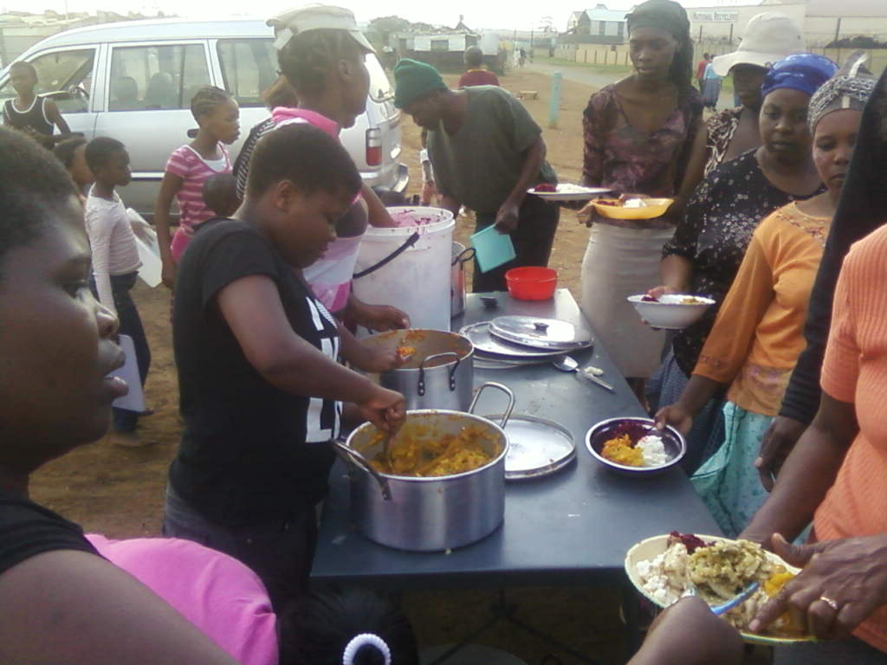
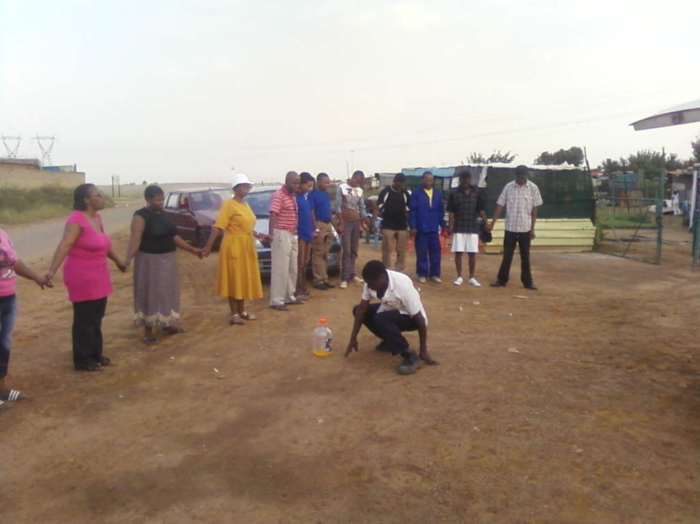
2009 March (SOUL CITY: Squatter camp)
On the same day on the 23rd of March we extend our programme and the organisation’s goals for that day, we decided to visit the squatter camp near a place called TAU BAZAR. This area (soul city) consists of many people who are unemployed and who are the obvious victims of poverty. The organisation decided to share a plate of food with them. We donated food and tried to encourage and motivate them not to loose hope. It is one of the goals of the organisation to re-visit the area. But again to conclude the event was a success.

Slide 12
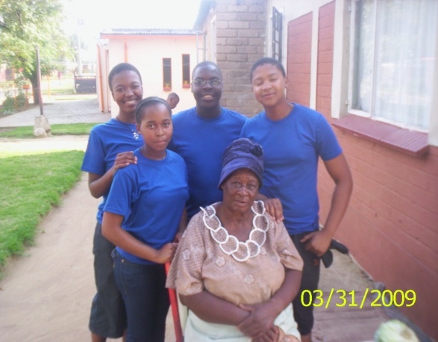
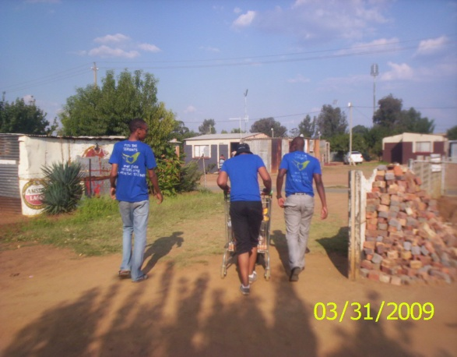
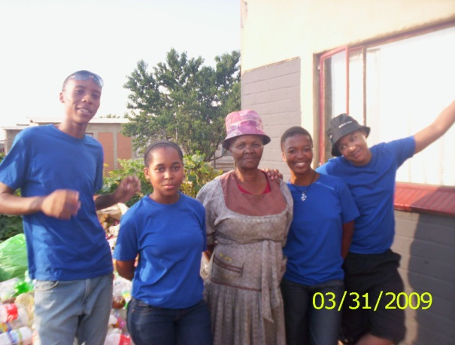
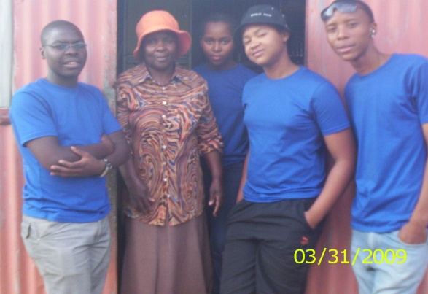
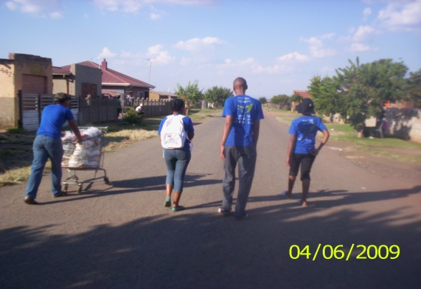
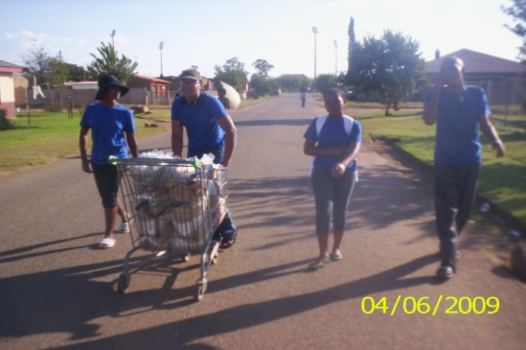
2009 March (HOUSE TO HOUSE VISITS)
On the 29th of March the organisation did the house-to-house visits to the disadvantaged groups to evaluate or study the living conditions of the groups. Honestly the results where bad. Some people go to bed with empty stomachs, others don’t even know what they will eat the following morning and lastly and very sad the families have children who are still attending either primary or secondary school and they don’t know what to prepare for their lunch.

Slide 13
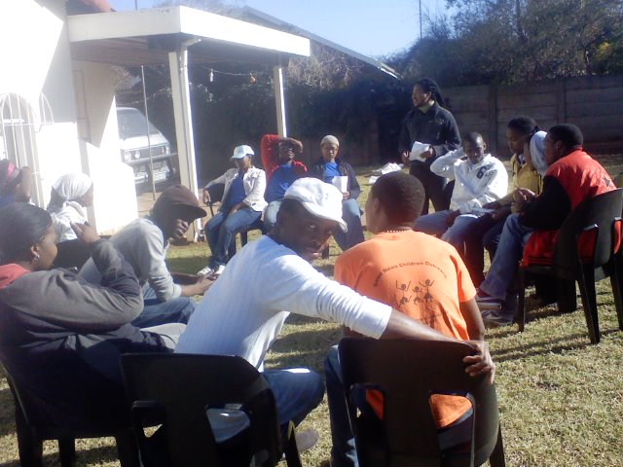
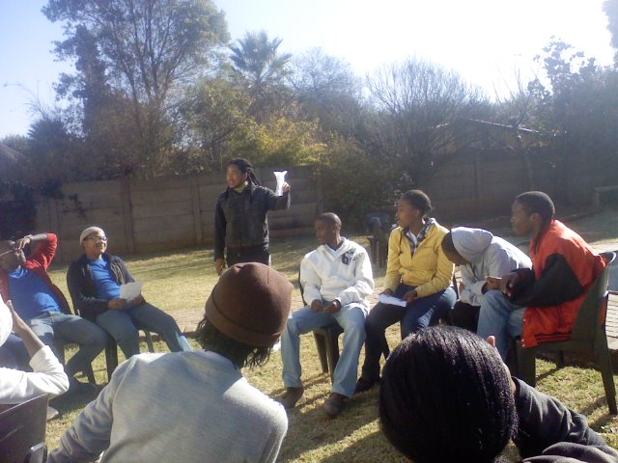
2009 June (BOND)
For the fact that the organisation had different people with different understanding about each other and different backgrounds which kind of prevented the members to participate to their level best, the organisation decided to face the group dynamics of the organisation and bring about understanding within the members of the organisation, all this was made through an innovative idea or event by the name of “BOND” meaning: a thing or action used to tie or fasten things or people together. In this case we were combining the individual members of the organisation so that when doing and implementing the tasks and activities of the organisation we can do all that with the same perspective, idea, energy, goals, aims, and apply equal efforts.

Slide 14
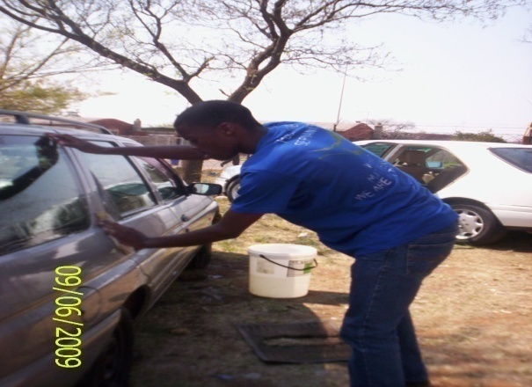
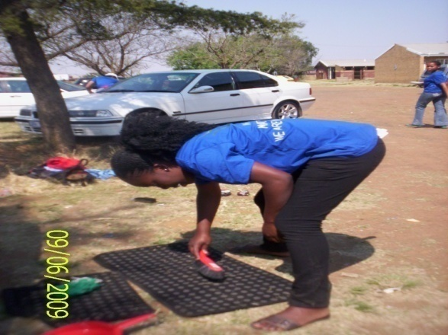
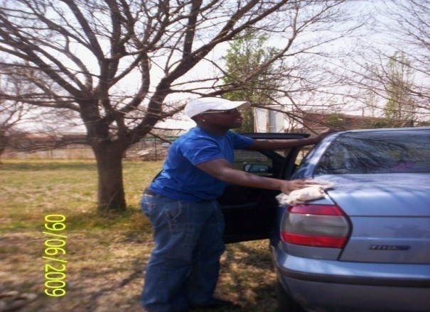
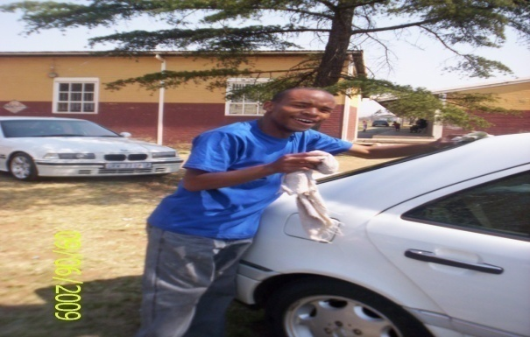
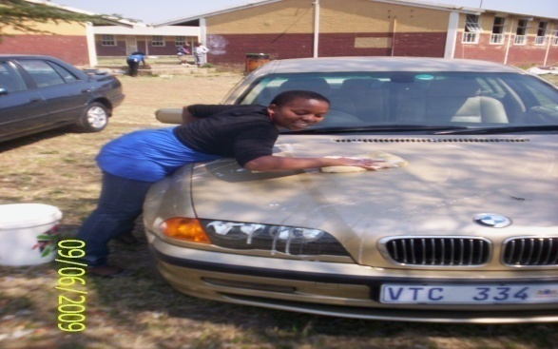
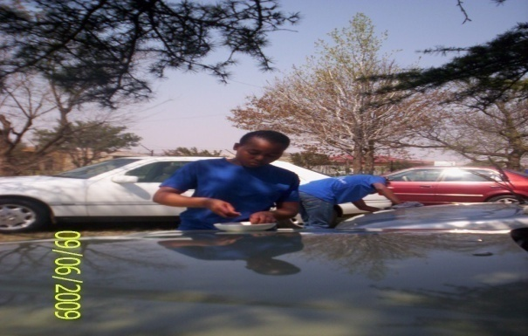
2009 SEPTEMBER (FUND RAISING)
For the fact that the organisation was still on the registration process and most of the things that they did they had to go deep into their pockets to help the needy, the organisation decided to raise funds that will assist them to help the community since it was difficult for them to get the sponsors from big companies because of the absence of the registration certificate. The idea of a car wash became the centre stage for raising funds.

Slide 15

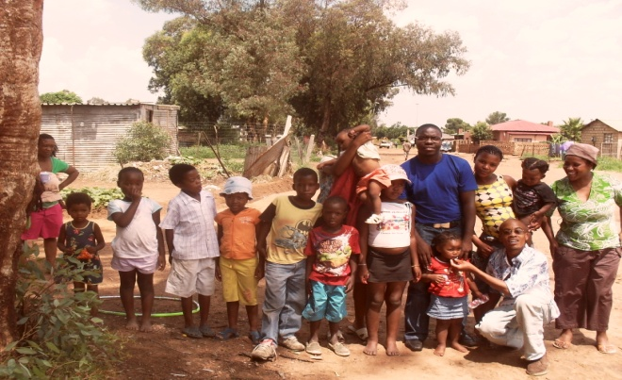
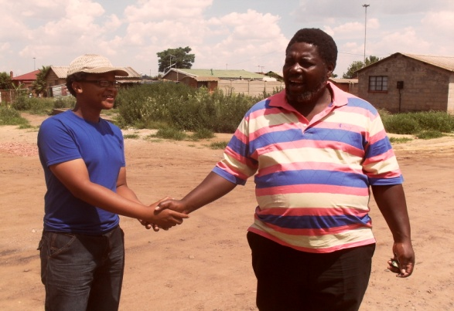
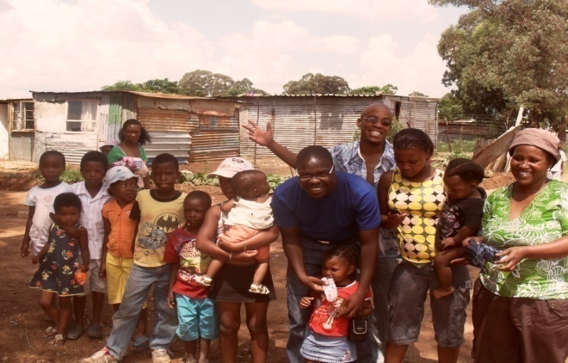
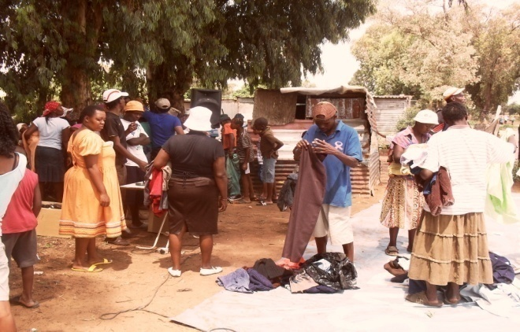
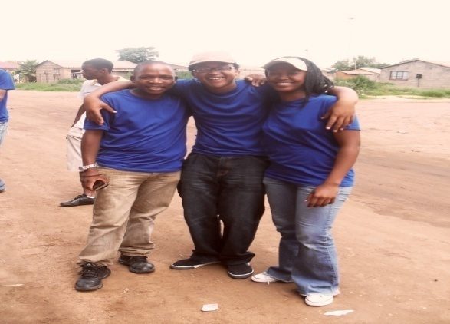
2009 December (LIBIA: SQUATTER CAMPS)
December is the month for celebration, happiness and exchanging gifts but what about the disadvantaged groups? Orphans? Old age? Unemployed people? The organisation decided to celebrate and exchange gifts with the disadvantaged groups in Sharpeville in a place called LIBIA which consists also like SOUL CITY of unemployed people. We donated clothes and many more to the group. Initially we thought the clothes were not sufficient but through the will of God the clothes were more than enough for everyone to get a share. In conclusion the event was a success and our gift to the community was love and compassion.

Slide 16
2010 Chairperson’s strategy
I was chosen as the chairperson of the organisation and i have reviewed some of the organisation’s strategies and made some amendments. These amendments are the organisation’s new management strategies. The amendments are as follows:
The majority rule principle will no longer be a centre stage for ideas, the organisation should be able to identify the strategies implemented by the chairperson and the management team which not negotiable unless other ways and the strategies implemented by the organisation at large which are negotiable or open to discussions.
Formal presentation of ideas at the meetings should be the centre stage of presenting the ideas.
Every member of the organisation should conduct a research on every aspects of the organisation and present the results on every meeting. The research should be based on: shelters available in the vaal, how to manage the group dynamics, how to implement strategies, what should be done on the events, and others...
...the majority rule will now come in when the approval is needed to the ideas being presented.
Every member should sign a contract and membership form with the organisation and absenteeism will not be tolerated and the contract will be terminated if the member does not comply with the rules and regulations of the organisation including the constitution.
The marketing team should be formed, meaning four to six members should be recruited ( the strategy of recruitment will be forwarded soon).
The organisation will atleast have one general meeting a year with its sponsors.
We will only have one meeting a month and the members are required not to wait for the phone calls or formal announcement of the upcoming meetings. (every last Saturday of the month at 15:00), venue: Kgomoco primary school.

Slide 17
Announcements
The organisation was advised to adopt the social development constitution and edit at the later stage for the registration process to be quick or fast. The chairperson attended the meeting
The organisation has been chosen in the local heroes competition and won R10 000 from NEDBANK. The chairperson also attended this meeting and the banking details are required from the organisation and to open a bank account at the bank the certificate of registration is required.
In 2009 our vice chairperson by the name of Sophia Makgale resigned from the organisation.
Most people recently shown a lack of interest to the organisation and this was measured through absenteeism and the organisation decided that with or without people the organisation will still exist. The number doesn’t matter but what matters is the work of the organisation.
The organisation will only host events from June onwards.
One meeting a month
Masesi Lydia Radebe was chosen as the new Secretary to replace Matshediso who is no longer available in the vaal because of her duties outside the region.
Soso John was chosen as the acting vice Chairperson to replace Sophia Makgale. The vice chairperson will be elected soon through performance and loyalty to the organisation
The new logo has been approved ( see the last page)

Slide 18
2008 to 2010 Sponsors
Ms Gail Johnson from Nkosi’s Heaven and Soweto Gospel choir
Contact numbers: +27 11 942 5580/1/3/4
Cell: +27 82 593 1999
Fax: +27 11 941 1408
www.nkosi.iafrica.com
JET Store at Vaal Mall
Happy Mabona: Sharpeville Pharmacy
Contact numbers:
Cell: +27 82 685 0897
Mingos Supermarket in Sharpeville
Nedbank
And other community members including volunteers

Slide 19
OFFICE BEARERS CONTACTS
Chairperson: Paseka Harry Motaung
Cell: +27 84 239 7291
Email: hpaseka@webmail.co.za
Acting vice chairperson: Soso John Happy
Cell: +27 74 519 7562
Email: 200922507@uj.ac.za
Treasure: Makgadi Evelyn Malete
Cell: +27 84 774 4966
Email: emakgadi@gmail.com
Secretary: Masesi Lydia Radebe
Cell: +27 72 043 3677
Email: rmasesipalesa@yahoo.com
Vice Secretary: Bongani Dlova
Cell: +27 73 951 4334
Legal officer: Lehloonolo Patrick Maile
Cell: +27 73 726 6772
Email:
Organiser: Paul
Cell: +27

Slide 20
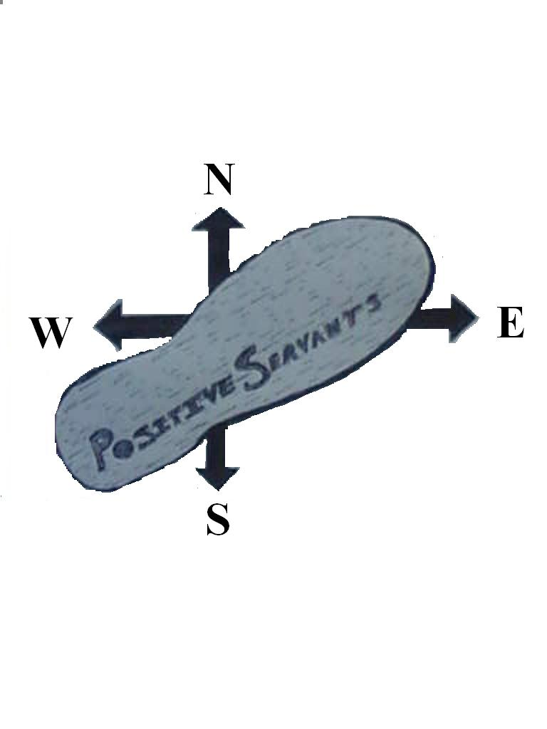
THE NEW LOGO OF THE ORGANISATION
“Whatever matters arise we are in his together”

Slide 21
END OF THE REPORT
BY: CHAIPERSON: PH MOTAUNG
DATE: 31 MARCH 2010
POSITIVE SERVANTS
SIGNED BY
Chairperson: _____________________
Secretary:________________________
P.R.O:___________________________
Legal Officer:_____________________

